Slide 1
RPi Shutdown Switch

Slide 2
Objective
Try a way to flip a swith to have the raspberry pi shut down. The motivation is that it can be fairly taxing to connect to issue the command sudo shutdown now. This command is necessary to make sure that the operating system writes out the cash to the SD card; if it doesn't, it can destroy the file structure on the SD card. One convenient switch could protect the SD card file structure from power shut offs.

Slide 3
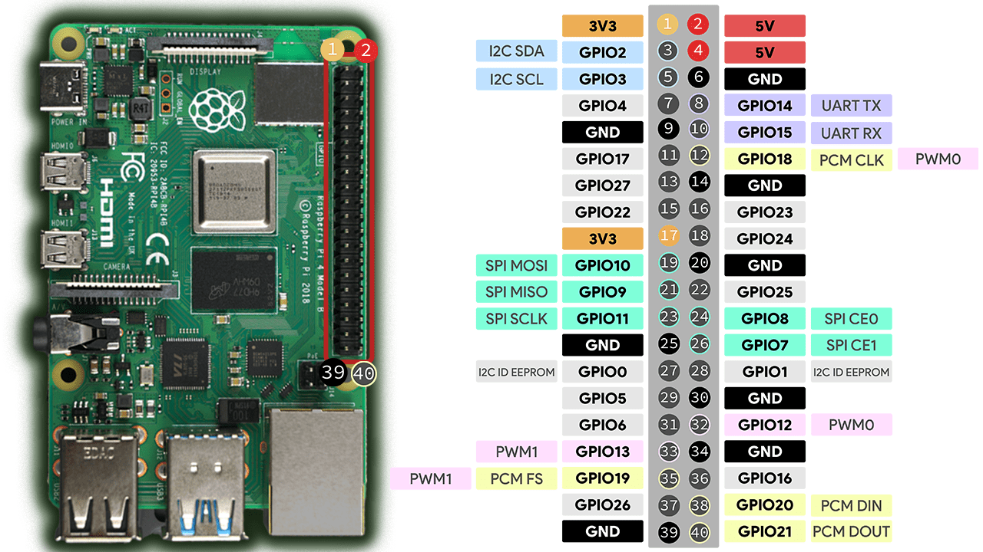
RPi 4 Pinout
Need I2C?
Use a different
overlay for I2C

Slide 4
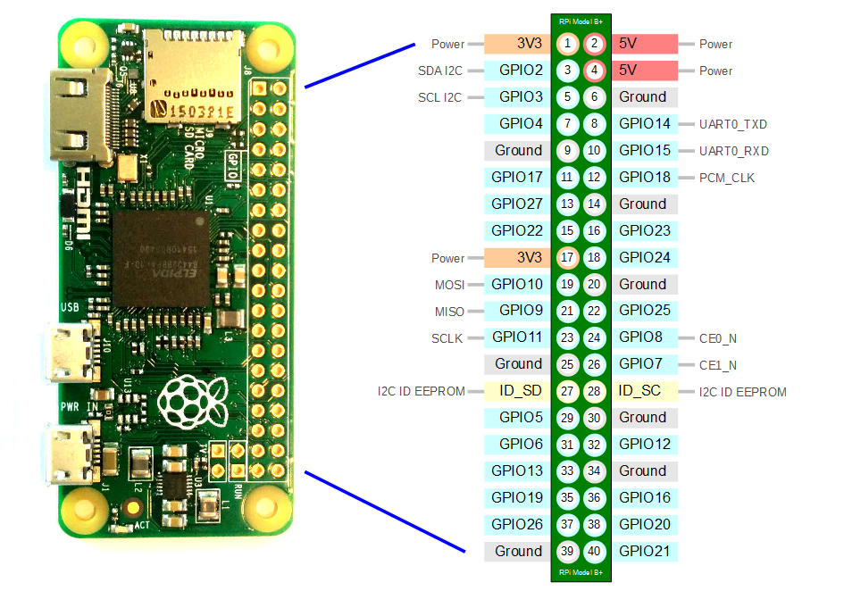
RPi Z Pinout
Need I2C?
Use a different
overlay for I2C

Slide 5
The overlay’s function
// This overlay sets up an input device that generates KEY_POWER events
// when a given GPIO pin changes. It defaults to using GPIO3, which can
// also be used to wake up (start) the Rpi again after shutdown. Since
// wakeup is active-low, this defaults to active-low with a pullup
// enabled, but all of this can be changed using overlay parameters (but
// note that GPIO3 has an external pullup on at least some boards).
https://github.com/raspberrypi/linux/pull/2103/commits/6cb4827afd84587011fe16e8d6dee87081faa8e6

Slide 6
Bootloader also uses GPIO3
The EPROM is configured by default to enable the MXL7704 PMIC when shut down. So you can now reboot by pulling pin 5 low.
It is possible to change this behavior by modifying the Pi4 EEPROM. See Pi 4 Bootloader Configuration.
https://raspberrypi.stackexchange.com/questions/19718/will-pulling-pin-5-low-will-make-the-pi-boot-up-again

Slide 7
Consider an on-off switch
Flip the switch from off to on will cause it to shutdown.
After it has shutdown or before power up again, flip the switch back to “off”.
It seems to read that it will shutdown when the pin state changes from hi (switch off) to low. So if you did power it up with the switch in the shutdown position, just flip it, nothing will happen.

